Slide 1
The Bag of Holding
Karolina Dudek

Slide 2
The Brief
The brief
Solution
Testing
Front End
CI Pipeline
Demonstration
Summary
Technology restrictions:
Kanban Board: Trello or an equivalent Kanban Board
Database: h2
Programming language: Java (unless stated otherwise)
Front-end: HTML, CSS and JavaScript, possibly using a front-end library such as React
Unit Tests: JUnit and Mockito
Integration Tests: Selenium
Version Control: Git
CI Server: Jenkins
Cloud server: AWS, GCP or Azure virtual machine
Individual work
CI pipeline
80% test coverage
OOP based application
CRUD functionality

Slide 3
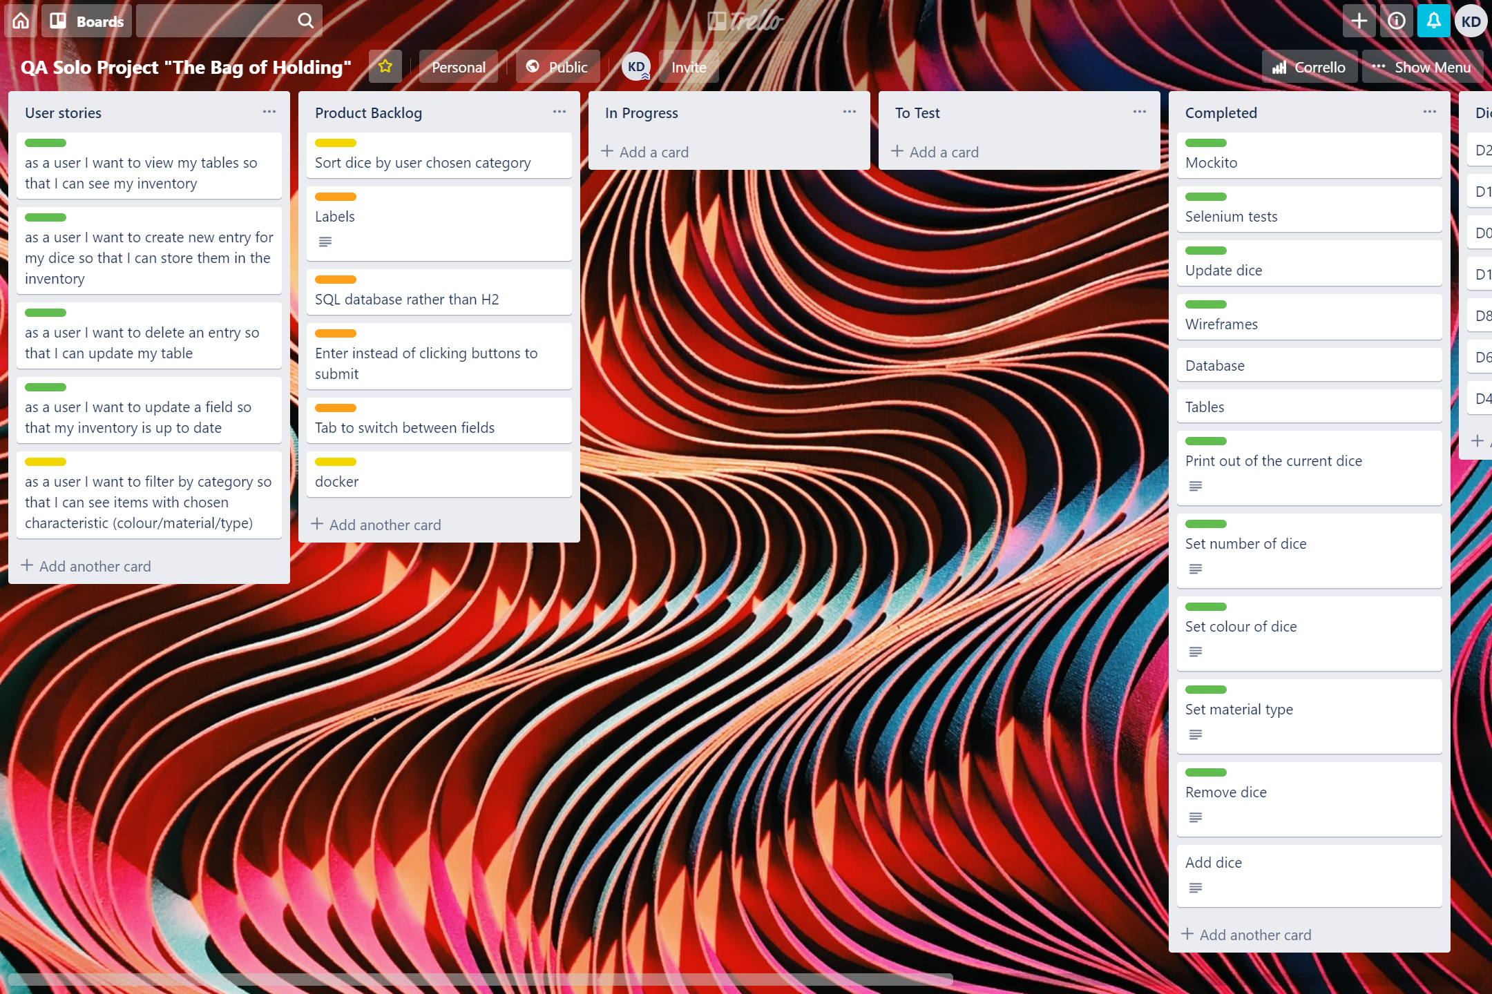
Project tracking - Trello
The brief
Solution
Testing
Front End
CI Pipeline
Demonstration
Summary

Slide 4
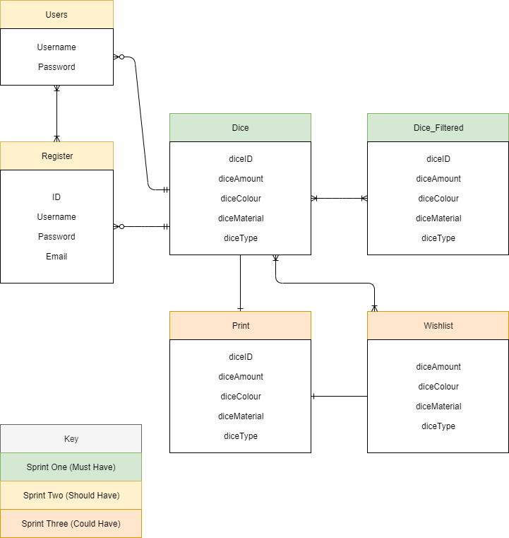
Proposed - Entity Relationship Diagrams
The brief
Solution
Testing
Front End
CI Pipeline
Demonstration
Summary

Slide 5
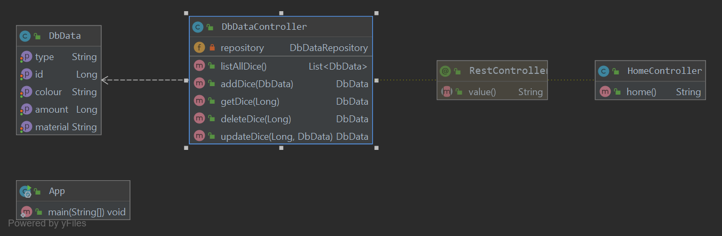
Final - Entity Relationship Diagrams
The brief
Solution
Testing
Front End
CI Pipeline
Demonstration
Summary

Slide 6
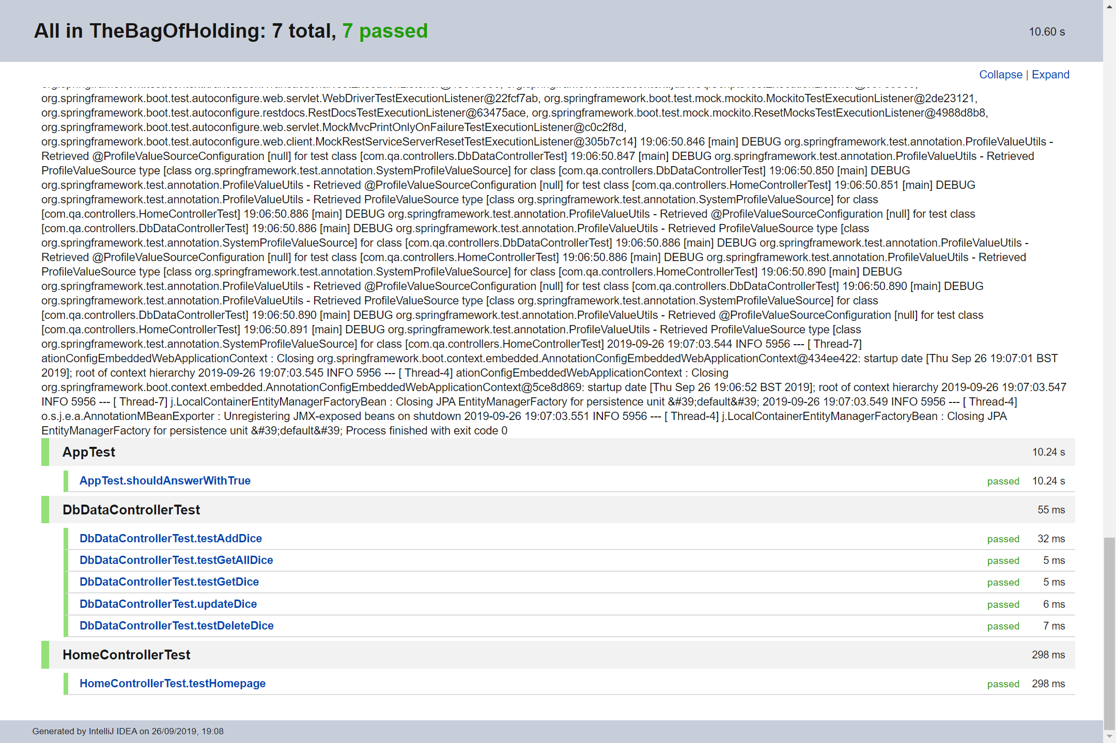
Testing – JUnit & Mockito
The brief
Solution
Testing
Front End
CI Pipeline
Demonstration
Summary

Slide 7
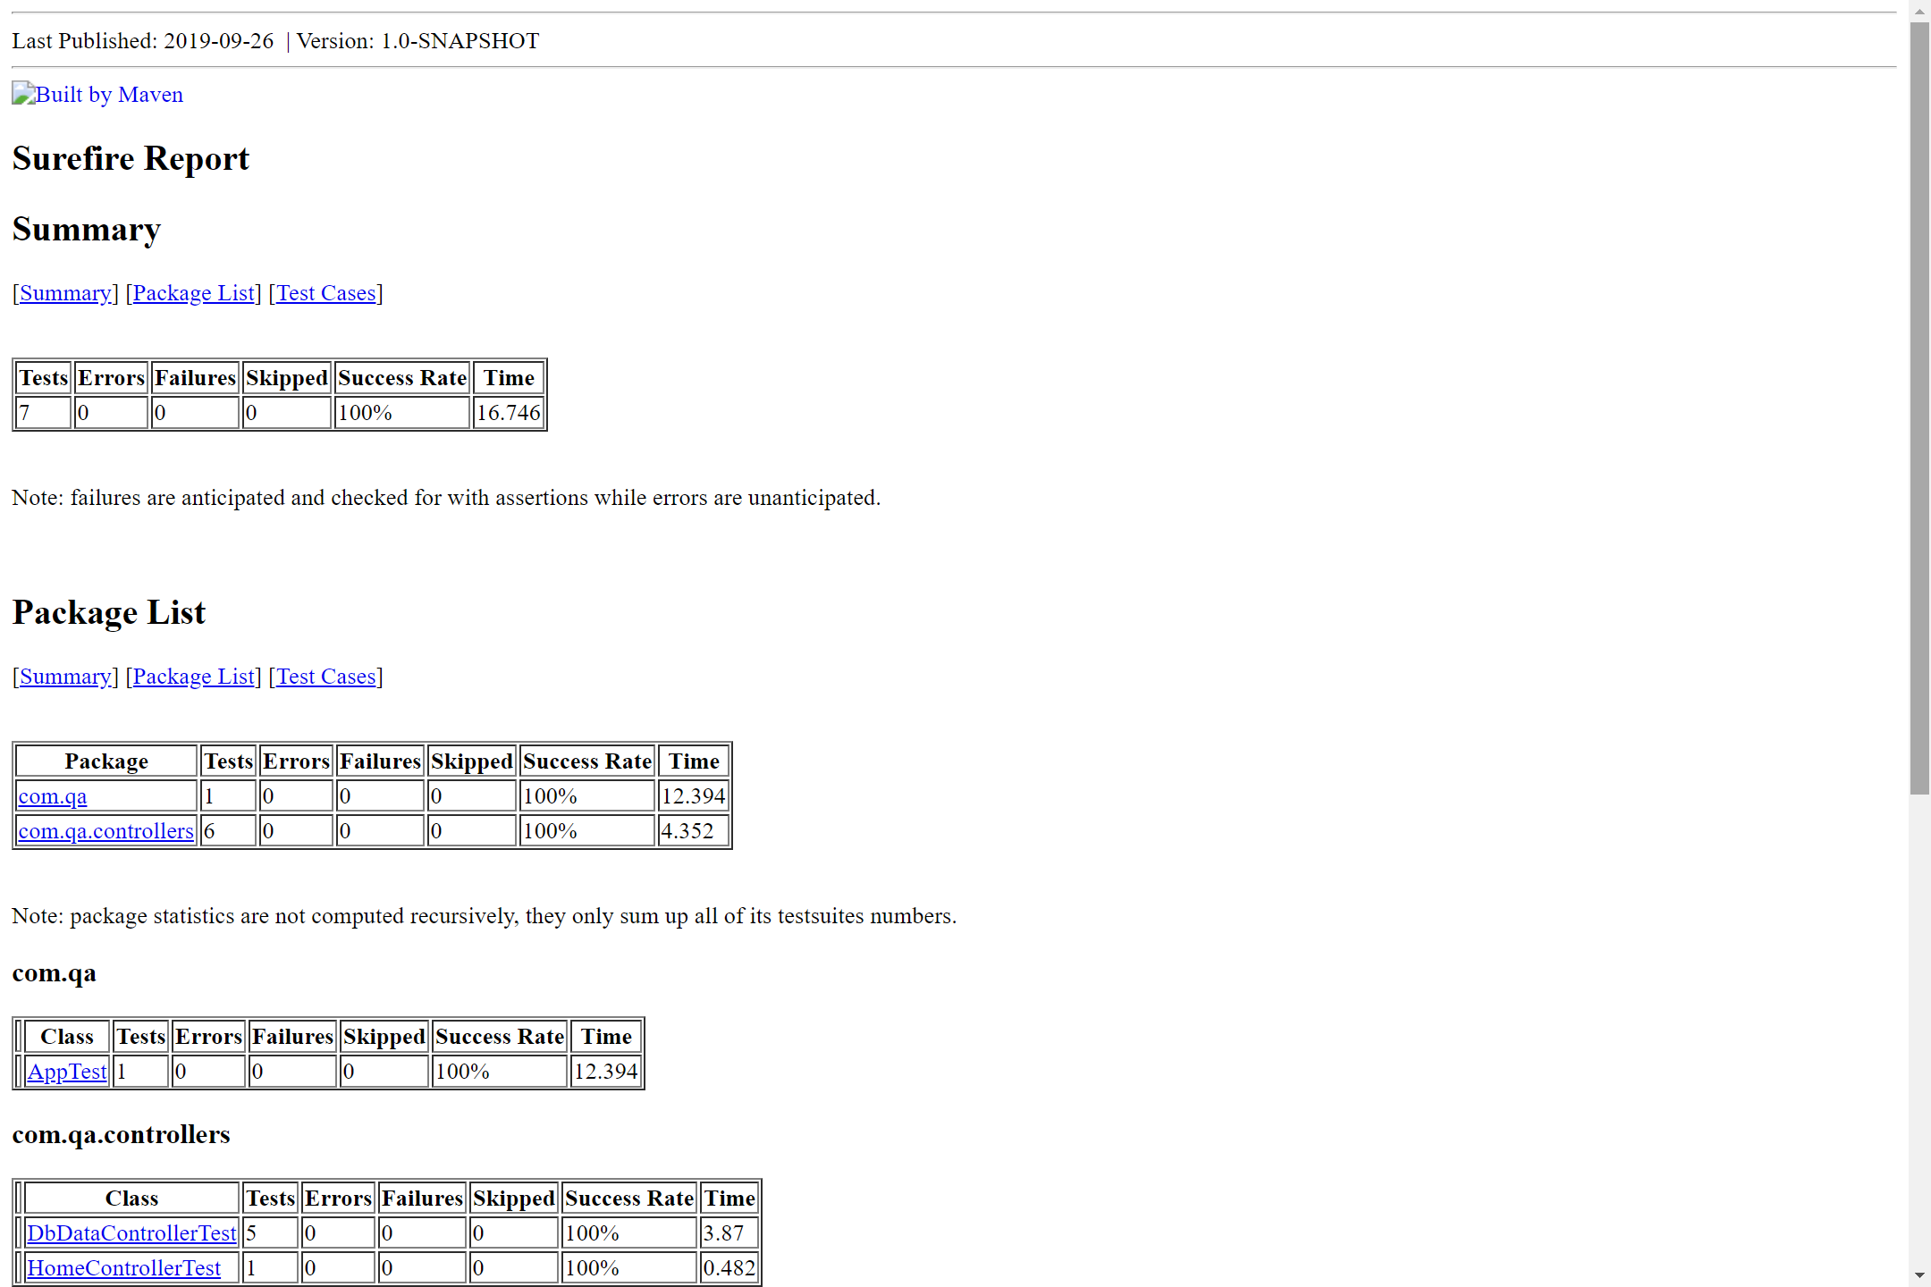
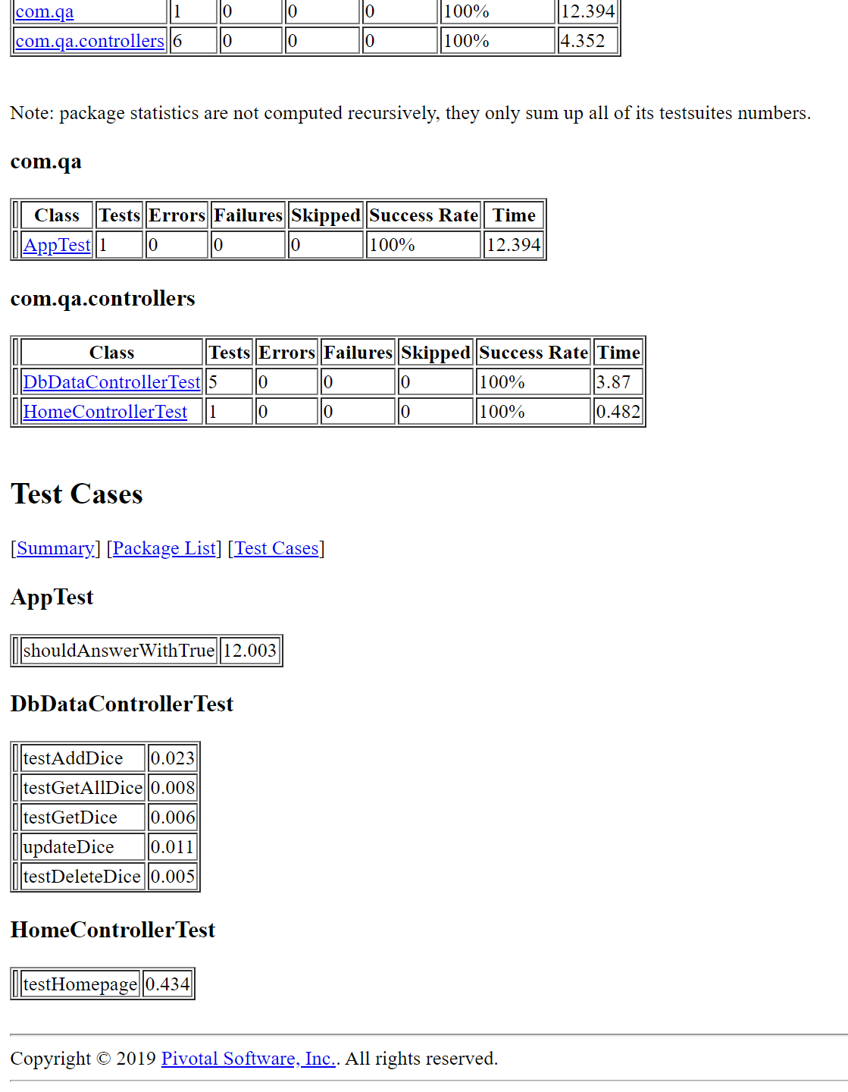
Testing – Surefire Report
The brief
Solution
Testing
Front End
CI Pipeline
Demonstration
Summary

Slide 8
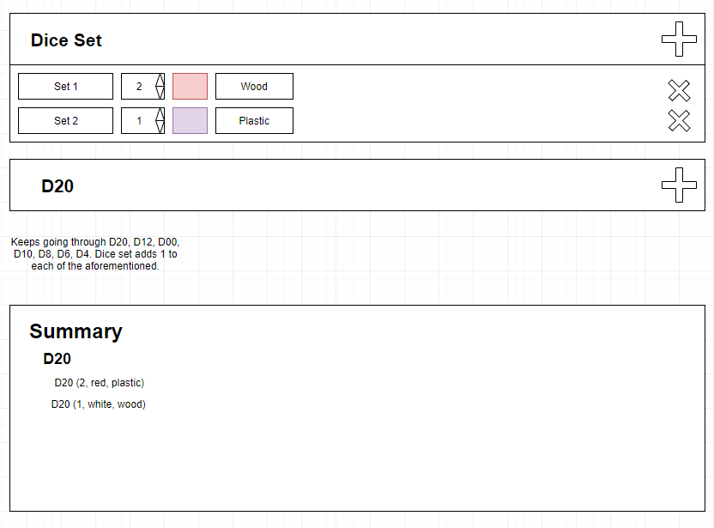
Dashboard – Initial Wireframe
The brief
Solution
Testing
Front End
CI Pipeline
Demonstration
Summary

Slide 9
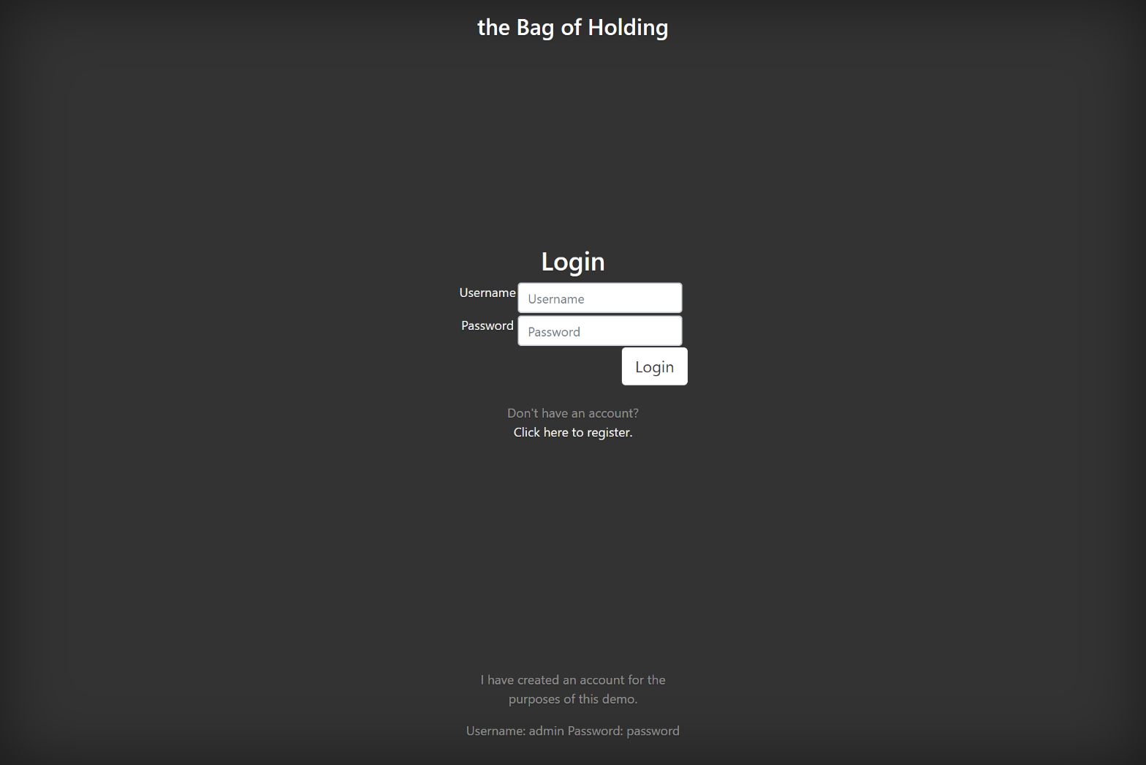
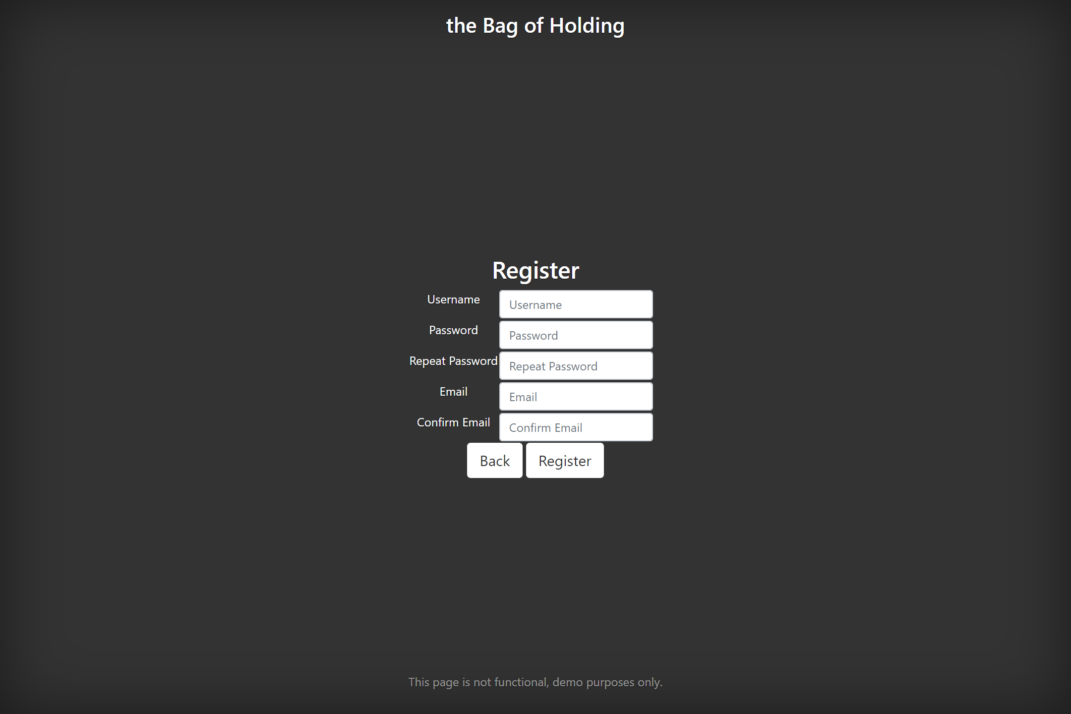
Index – Login & Registration
The brief
Solution
Testing
Front End
CI Pipeline
Demonstration
Summary

Slide 10
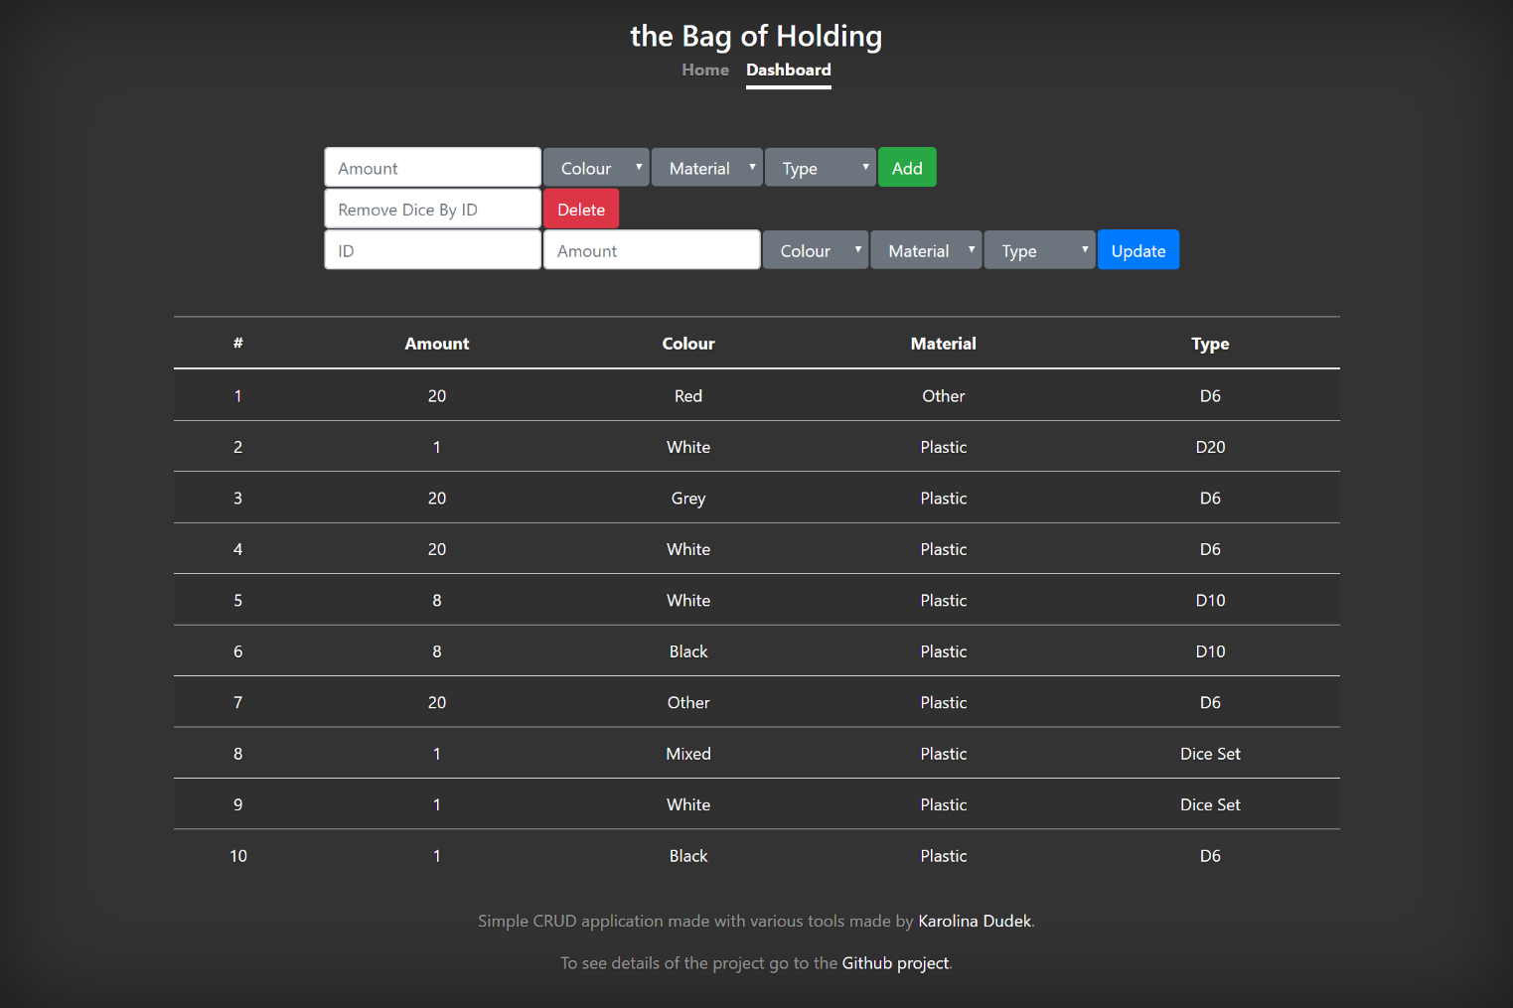
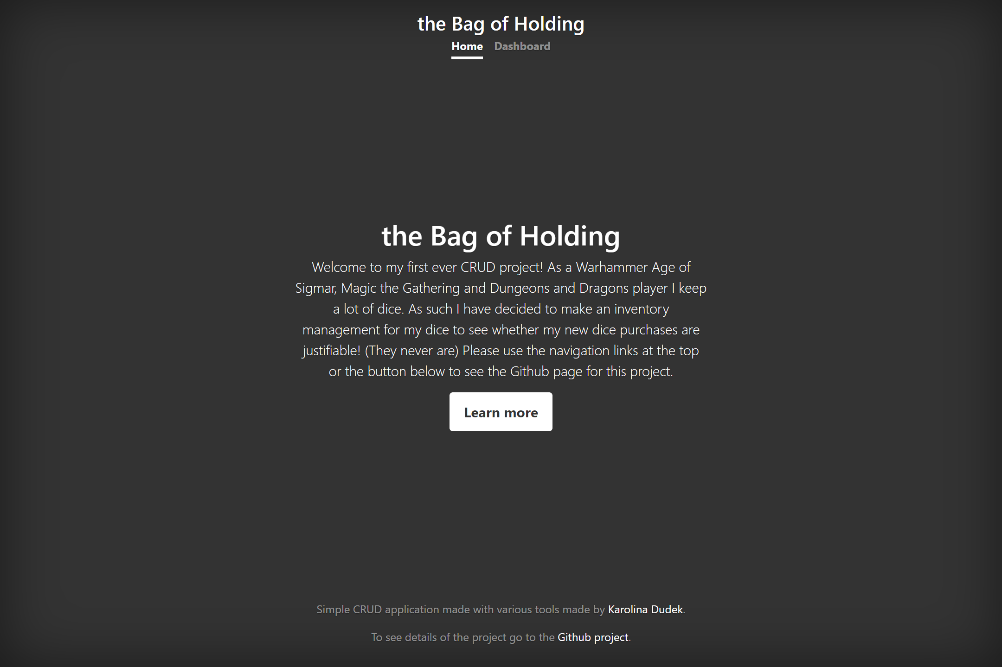
Index – Home & Dashboard
The brief
Solution
Testing
Front End
CI Pipeline
Demonstration
Summary

Slide 11
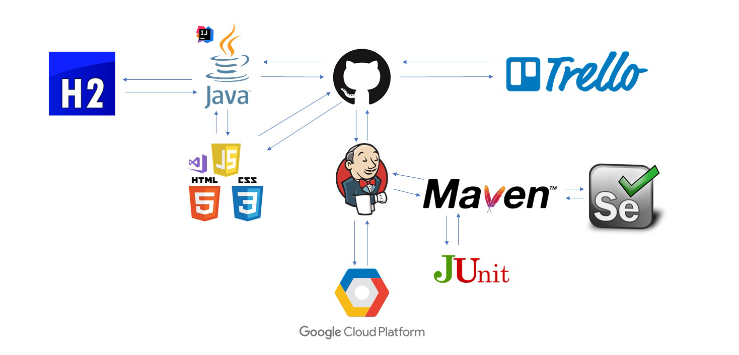
Technologies Used – CI Pipeline
The brief
Solution
Testing
Front End
CI Pipeline
Demonstration
Summary

Slide 12
Summary
The brief
Solution
Testing
Front End
CI Pipeline
Demonstration
Summary
Accomplishments
Functional CRUD application
Good UI
Ease of use
Scalable for commercial use
Improvements
Sortable tables
Ability to filter dice by colour, material or type
Sort by amount of dice
Implementation of Docker
mySQL database rather than h2
Labels on HTML for screen readers
CRUD interface could be styled better

Slide 13
Demonstration
The brief
Solution
Testing
Front End
CI Pipeline
Demonstration
Summary

Slide 14
Questions and Feedback
Thank you for listening

